Slide 1
RVC_ASAP RISCV Core As-Fast-As-Possible
Project facilitator: Amichai Ben-David Students: Gil ya’akov & Matan eshel

Slide 2
Agenda
RISC ISA format and Instructions
Core Stages
Data Path & Block diagram
Ctrl Logic
Coding Style
Git and repository structure
What’s next?

Slide 3
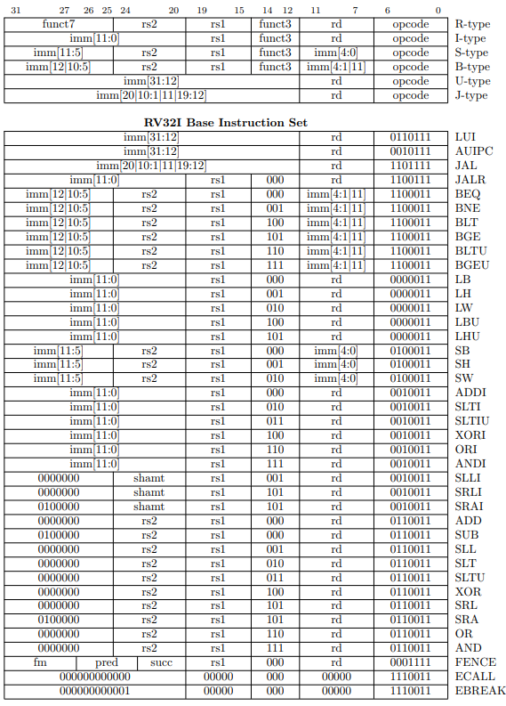
RISCV ISA: Format & Instructions

Slide 4
RISCV ISA: R-Type

Slide 5
RISCV ISA: I-Type

Slide 6
RISCV ISA: S-Type

Slide 7
RISCV ISA: B-Type

Slide 8
RISCV ISA: U-Type

Slide 9
RISCV ISA: J-Type

Slide 10
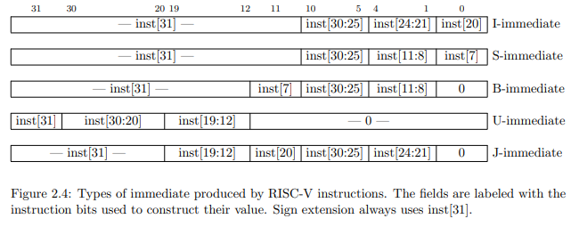
RISCV ISA – Format & Instructions

Slide 11
RISCV ISA – Format & Instructions

Slide 12
RISCV ISA – Format & Instructions
unique casez (SelImmType)
U_TYPE : Immediate = { Instruction[31:12], 12'b0 } ;
I_TYPE : Immediate = { {20{Instruction[31]}} , Instruction[31:20] };
S_TYPE : Immediate = { {20{Instruction[31]}} , Instruction[31:25] , Instruction[11:7] };
B_TYPE : Immediate = { {20{Instruction[31]}} , Instruction[7] , Instruction[30:25] , Instruction[11:8] , 1'b0};
J_TYPE : Immediate = { {12{Instruction[31]}} , Instruction[19:12] , Instruction[20] , Instruction[30:21] , 1'b0};
default: Immediate = { Instruction[31:12], 12'b0 };
endcase

Slide 13
Core Stages - Description
//===========================================================================
Instruction fetch
// 1. Send the PC (Program Counter) to the I_MEM.
// 2. Set the Next Pc -> Pc+4 or Calculated Address.
//===========================================================================
//===========================================================================
Decode
// 1. Get the instruction from I_MEM and use the "decoder" to set the Ctrl Bits.
// 2. Construct the Immediate types.
// 3. Use the RS1 & RS2 (RegSrc) to read the Register file data.
//===========================================================================
//===========================================================================
Execute
// 1. Compute Data to write back to register.
// 2. Compute Address for load/store
// 3. Compute Branch/Jump address target. (set PC)
// 4. Check branch condition
//===========================================================================
//===========================================================================
Memory Access
// Acceess D_MEM for Write (STORE) and Reads (LOAD). – use Byte Enable and Sign-Extend indications.
//===========================================================================
//===========================================================================
Write-Back
// Select data write back to register file -> AluOut vs DMemRdData
//===========================================================================

Slide 14
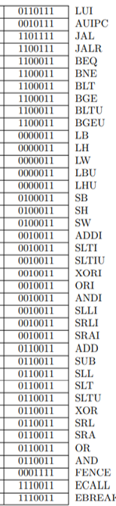
Core Stages - Building blocks

Slide 15
RegReg-Type

Slide 16
RegReg-Type
CtrlBits
CtrlBits
RegDst
RegSrc1/2
RegData1
PC
AluOut
RegData2
Instruction
Instruction

Slide 17
ImmReg-type

Slide 18
STORE

Slide 19
LOAD

Slide 20
LUI

Slide 21
AUIPC

Slide 22
JAL

Slide 23
JALR

Slide 24
BRANCH

Slide 25
Full Connectivity

Slide 26
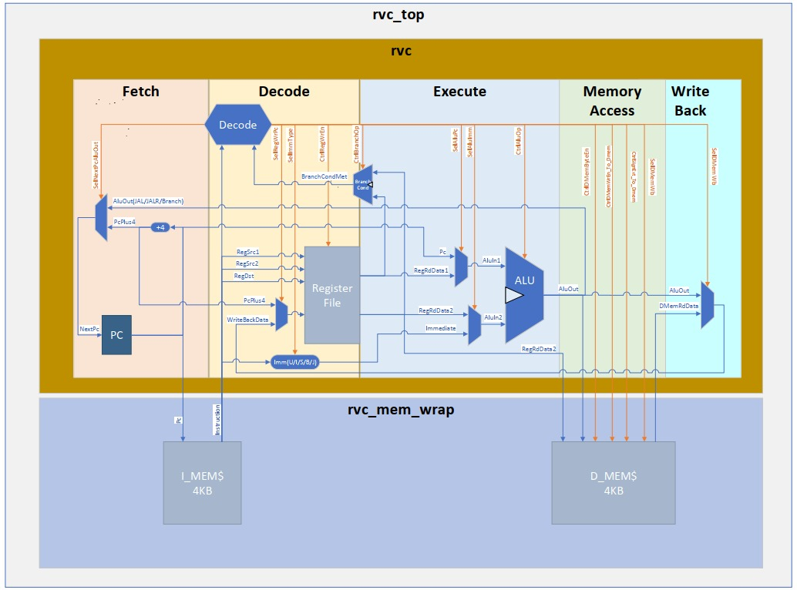
Data Path
//Data Path
logic [31:0] Pc;
logic [31:0] NextPc;
logic [31:0] PcPlus4;
logic [31:0] Instruction;
logic [31:1][31:0] Register;
logic [31:0] Immediate;
logic [4:0] Shamt;
logic [31:0] PreDMemRdData;
logic [31:0] DMemRdData;
logic [31:0] AluIn1;
logic [31:0] AluIn2;
logic [31:0] AluOut;
logic [31:0] RegRdData1;
logic [31:0] RegRdData2;
logic [31:0] RegWrData;
logic [31:0] WrBackData;
//Behavrial Memory
logic [7:0] Imem [I_MEM_MSB:0];
logic [7:0] Dmem [D_MEM_MSB:I_MEM_MSB+1];

Slide 27
Control Bits
//Ctrl Bits
logic SelNextPcAluOut;
logic SelRegWrPc;
logic BranchCondMet;
logic SelDMemWb;
logic SelAluPc ;
logic SelAluImm;
t_immediate SelImmType;
t_branch_type CtrlBranchOp;
logic [3:0] CtrlDMemByteEn;
logic CtrlDMemWrEn;
logic CtrlSignExt;
t_alu_op CtrlAluOp;
//mean terms
t_opcode Opcode;
logic [2:0] Funct3;
logic [6:0] Funct7;
logic [4:0] RegSrc1, RegSrc2, RegDst;

Slide 28
Coding Style Parameters , Enumerate
//Ctrl Bits
logic SelNextPcAluOut;
logic SelRegWrPc;
logic BranchCondMet;
logic SelDMemWb;
logic SelAluPc ;
logic SelAluImm;
t_immediate SelImmType;
t_branch_type CtrlBranchOp;
logic [3:0] CtrlDMemByteEn;
logic CtrlDMemWrEn;
logic CtrlSignExt;
t_alu_op CtrlAluOp;
//mean terms
t_opcode Opcode;
logic [2:0] Funct3;
logic [6:0] Funct7;
logic [4:0] RegSrc1, RegSrc2, RegDst;
parameter I_MEM_MSB = 'h1000-1;
parameter D_MEM_MSB = 'h2000-1;
typedef enum logic [2:0] {
U_TYPE = 3'b000 ,
I_TYPE = 3'b001 ,
S_TYPE = 3'b010 ,
B_TYPE = 3'b011 ,
J_TYPE = 3'b100
} t_immediate ;
typedef enum logic [3:0] {
ADD = 4'b0000 ,
SUB = 4'b1000 ,
SLT = 4'b0010 ,
SLTU = 4'b0011 ,
SLL = 4'b0001 ,
SRL = 4'b0101 ,
SRA = 4'b1101 ,
XOR = 4'b0100 ,
OR = 4'b0110 ,
AND = 4'b0111
} t_alu_op ;
typedef enum logic [2:0] {
BEQ = 3'b000 ,
BNE = 3'b001 ,
BLT = 3'b100 ,
BGE = 3'b101 ,
BLTU = 3'b110 ,
BGEU = 3'b111
} t_branch_type ;
typedef enum logic [6:0] {
LUI = 7'b0110111 ,
AUIPC = 7'b0010111 ,
JAL = 7'b1101111 ,
JALR = 7'b1100111 ,
BRANCH = 7'b1100011 ,
LOAD = 7'b0000011 ,
STORE = 7'b0100011 ,
I_OP = 7'b0010011 ,
R_OP = 7'b0110011 ,
FENCE = 7'b0001111 ,
SYSCAL = 7'b1110011
} t_opcode ;

Slide 29
Coding Style Parameters , Enumerate
//Ctrl Bits
logic SelNextPcAluOut;
logic SelRegWrPc;
logic SelDMemWb;
logic SelAluPc ;
logic SelAluImm;
t_immediate SelImmType;
logic BranchCondMet;
t_branch_type CtrlBranchOp;
logic [3:0] CtrlDMemByteEn;
logic CtrlDMemWrEn;
t_alu_op CtrlAluOp;
//mean terms
t_opcode Opcode;
logic [2:0] Funct3;
logic [6:0] Funct7;
logic [4:0] RegSrc1, RegSrc2, RegDst;
parameter I_MEM_MSB = 'h1000-1;
parameter D_MEM_MSB = 'h2000-1;
typedef enum logic [2:0] {
U_TYPE = 3'b000 ,
I_TYPE = 3'b001 ,
S_TYPE = 3'b010 ,
B_TYPE = 3'b011 ,
J_TYPE = 3'b100
} t_immediate ;
typedef enum logic [3:0] {
ADD = 4'b0000 ,
SUB = 4'b1000 ,
SLT = 4'b0010 ,
SLTU = 4'b0011 ,
SLL = 4'b0001 ,
SRL = 4'b0101 ,
SRA = 4'b1101 ,
XOR = 4'b0100 ,
OR = 4'b0110 ,
AND = 4'b0111
} t_alu_op ;
typedef enum logic [2:0] {
BEQ = 3'b000 ,
BNE = 3'b001 ,
BLT = 3'b100 ,
BGE = 3'b101 ,
BLTU = 3'b110 ,
BGEU = 3'b111
} t_branch_type ;
typedef enum logic [6:0] {
LUI = 7'b0110111 ,
AUIPC = 7'b0010111 ,
JAL = 7'b1101111 ,
JALR = 7'b1100111 ,
BRANCH = 7'b1100011 ,
LOAD = 7'b0000011 ,
STORE = 7'b0100011 ,
I_OP = 7'b0010011 ,
R_OP = 7'b0110011 ,
FENCE = 7'b0001111 ,
SYSCAL = 7'b1110011
} t_opcode ;

Slide 30
Coding Style - Macros
`define RVC_MSFF(q,i,clk) \
always_ff @(posedge clk) \
q<=i;
`define RVC_EN_MSFF(q,i,clk,en) \
always_ff @(posedge clk) \
if(en) q<=i;
`define RVC_RST_MSFF(q,i,clk,rst) \
always_ff @(posedge clk) begin \
if (rst) q <='0; \
else q <= i; \
end
`define RVC_EN_RST_MSFF(q,i,clk,en,rst)\
always_ff @(posedge clk) \
if (rst) q <='0; \
else if(en) q <= i;
For sequential assignment we will use a macro.
This will allow us to design a combinatoric design, and every sequential logic will be marked with the “MSFF” macro. (Master-Slave-Flip-Flop)

Slide 31
File Header
//-----------------------------------------------------------------------------
// Title : riscv as-fast-as-possible
// Project : rvc_asap
//-----------------------------------------------------------------------------
// File : <TODO>
// Original Author : Amichai Ben-David
// Code Owner :
// Created : 11/2021
//-----------------------------------------------------------------------------
// Description :
//
//
//-----------------------------------------------------------------------------

Slide 32
Git & Model Structure
| buildl.sh
| .gitignore
| LICENSE
| README.md
+---apps
| +---asm
| +---C
| +---elf
| +---elf.txt
| +---sv
| crt0.s
| link.common.ld
| README.md
+---doc
| HOW_TO.md
| 5 stage pipeline.pptx
| HOW_TO_RUN_BUILDL.md
| HOW_TO_GIT.md
| riscv-spec-20191213.pdf
| rvc_asap.pptx
| single_cycle_RVC.png
+---modelsim_run
| README.md
| rvc_asap_list.f
| +---work
+---source
| README.md
| rvc_asap.sv
| rvc_asap_macros.sv
| rvc_asap_pkg.sv
| rvc_mem_wrap.sv
| rvc_top.sv
+---target
| +---addition
| +---additionrv32i
| +---basic_commands1
| +---basic_commands2
| +---jump_commands
| +---simple_add_test
| +---test_asap
+---verif
| README.md
| rvc_asap_tb.sv
| +---golden_image

Slide 33
What’s next?
Add to architecture pipeline staging
Add VGA control for running applications with visual interface on FPGA

Slide 34
Let’s Get Started!

Slide 35
Backup
unique casez (Opcode) //mux
JALR, I_OP, LOAD : SelImmType = I_TYPE;
LUI, AUIPC : SelImmType = U_TYPE;
JAL : SelImmType = J_TYPE;
BRANCH : SelImmType = B_TYPE;
STORE : SelImmType = S_TYPE;
default : SelImmType = I_TYPE;
endcase
always_comb begin : branch_comp
//for branch condition.
unique casez ({CtrlBranchOp})
BEQ : BranchCondMet = (RegRdData1==RegRdData2) ;// BEQ
BNE : BranchCondMet = ~(RegRdData1==RegRdData2) ;// BNE
BLT : BranchCondMet = ($signed(RegRdData1)<$signed(RegRdData2)) ;// BLT
BGE : BranchCondMet = ~($signed(RegRdData1)<$signed(RegRdData2)) ;// BGE
BLTU : BranchCondMet = (RegRdData1<RegRdData2) ;// BLTU
BGEU : BranchCondMet = ~(RegRdData1<RegRdData2) ;// BGEU
default : BranchCondMet = 1'b0 ;
endcase
end

Slide 36
Backup
always_comb begin
unique casez ({Funct3, Funct7, Opcode})
//-----R type-------
{3'b000, 7'b0000000, R_OP} : CtrlAluOp = ADD; //ADD
{3'b000, 7'b0100000, R_OP} : CtrlAluOp = SUB; //SUB
{3'b001, 7'b0000000, R_OP} : CtrlAluOp = SLL; //SLL
{3'b010, 7'b0000000, R_OP} : CtrlAluOp = SLT; //SLT
{3'b011, 7'b0000000, R_OP} : CtrlAluOp = SLTU;//SLTU
{3'b100, 7'b0000000, R_OP} : CtrlAluOp = XOR; //XOR
{3'b101, 7'b0000000, R_OP} : CtrlAluOp = SRL; //SRL
{3'b101, 7'b0100000, R_OP} : CtrlAluOp = SRA; //SRA
{3'b110, 7'b0000000, R_OP} : CtrlAluOp = OR; //OR
{3'b111, 7'b0000000, R_OP} : CtrlAluOp = AND; //AND
//-----I type-------
{3'b000, 7'b???????, I_OP} : CtrlAluOp = ADD; //ADDI
{3'b010, 7'b???????, I_OP} : CtrlAluOp = SLT; //SLTI
{3'b011, 7'b???????, I_OP} : CtrlAluOp = SLTU;//SLTUI
{3'b100, 7'b???????, I_OP} : CtrlAluOp = XOR; //XORI
{3'b110, 7'b???????, I_OP} : CtrlAluOp = OR; //ORI
{3'b111, 7'b???????, I_OP} : CtrlAluOp = AND; //ANDI
{3'b001, 7'b0000000, I_OP} : CtrlAluOp = SLL; //SLLI
{3'b101, 7'b0000000, I_OP} : CtrlAluOp = SRL; //SRLI
{3'b101, 7'b0100000, I_OP} : CtrlAluOp = SRA; //SRAI
//-----Other-------
default : CtrlAluOp = ADD; //LUI || AUIPC || JAL || JALR || BRANCH || LOAD || STORE
endcase
end

Slide 37
Backup
assign Opcode = t_opcode'(Instruction[6:0]);
assign Funct3 = Instruction[14:12];
assign Funct7 = Instruction[31:25];
assign SelNextPcAluOut = (Opcode == JAL) || (Opcode == JALR) || ((Opcode == BRANCH) && BranchCondMet);
assign SelRegWrPc = (Opcode == JAL) || (Opcode == JALR);
assign SelAluPc = (Opcode == JAL) || (Opcode == BRANCH) || (Opcode == AUIPC);
assign SelAluImm =!(Opcode == R_OP);// In case of RegReg Operation the Imm Selector is deasserted - defualt is asserted
assign SelDMemWb = (Opcode == LOAD);
assign CtrlLui = (Opcode == LUI);
assign CtrlRegWrEn = (Opcode == LUI ) || (Opcode == AUIPC) || (Opcode == JAL) || (Opcode == JALR) ||
(Opcode == LOAD) || (Opcode == I_OP) || (Opcode == R_OP) || (Opcode == FENCE);
assign CtrlDMemWrEn = (Opcode == STORE);
assign CtrlSignExt = (Opcode == LOAD) && (!Funct3[2]);//Sign extend the LOAD from memory read.
assign CtrlDMemByteEn = ((Opcode == LOAD) || (Opcode == STORE)) && (Funct3[1:0] == 2'b00) ? 4'b0001 :// LB || SB
((Opcode == LOAD) || (Opcode == STORE)) && (Funct3[1:0] == 2'b01) ? 4'b0011 :// LH || SH
((Opcode == LOAD) || (Opcode == STORE)) && (Funct3[1:0] == 2'b10) ? 4'b1111 :// LW || SW
4'b0000 ;

